Slide 1
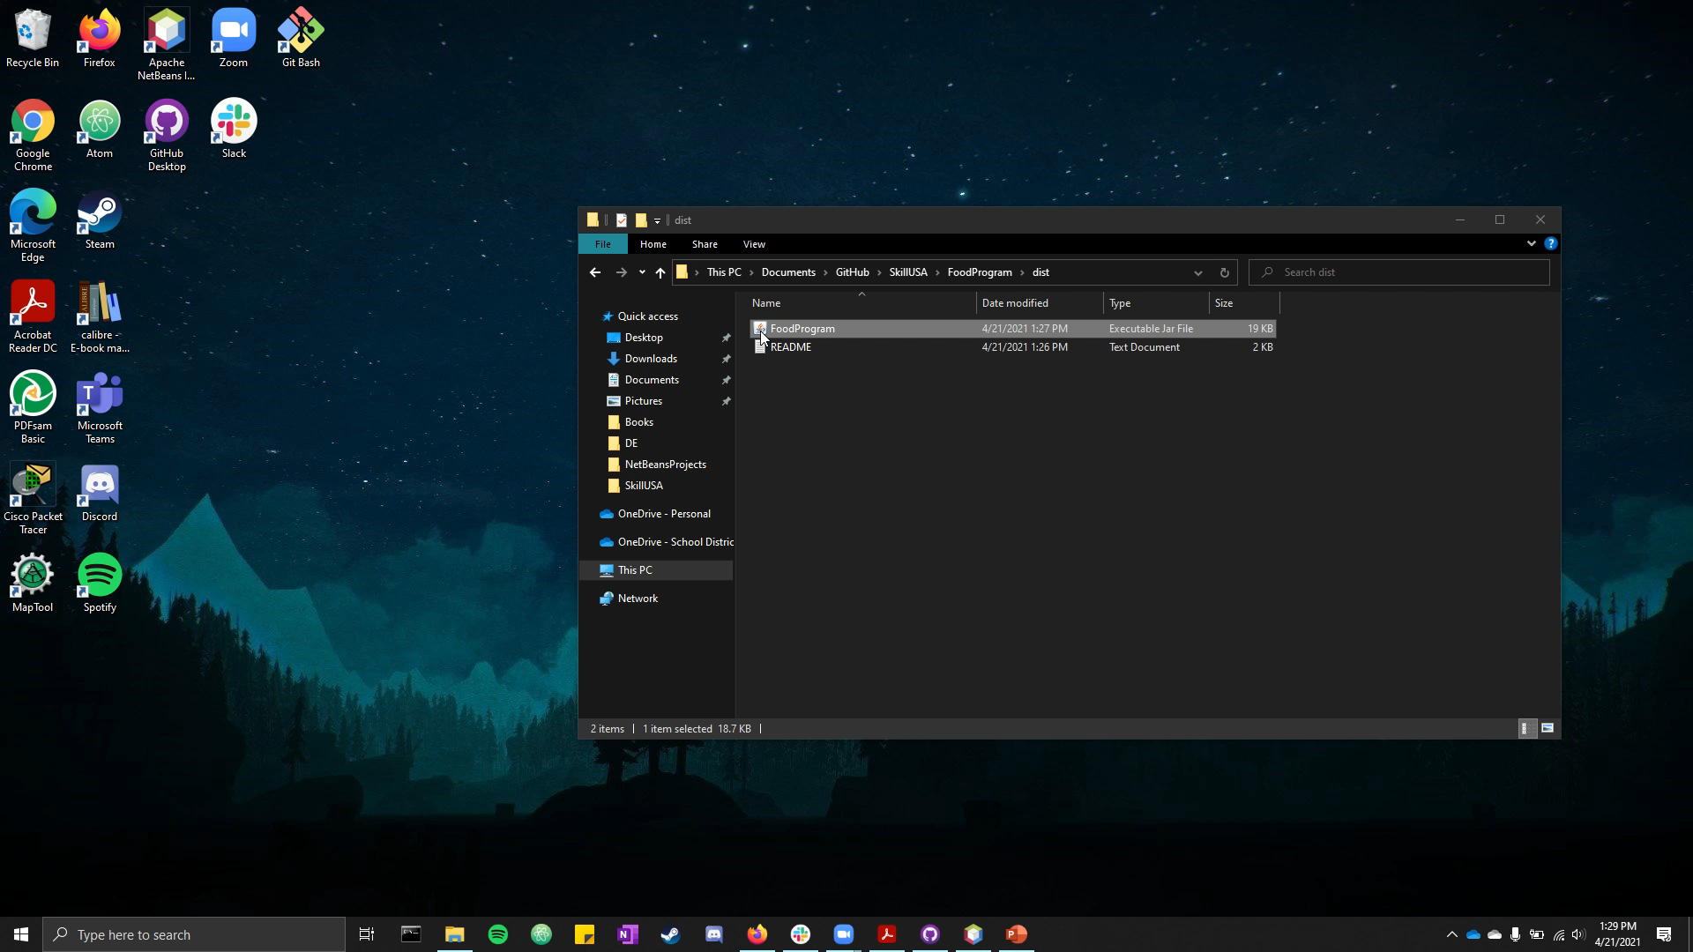
Allie Bacholl Program #1 Food Program

